Slide 1

UNCLASSIFIED
Mobile Derived Credentials
Purebred Information Brief
UNCLASSIFIED
UNITED IN SERVICE TO OUR NATION

Slide 2
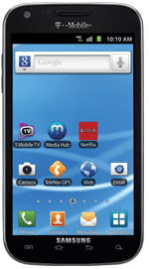
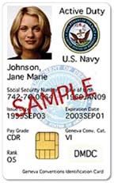

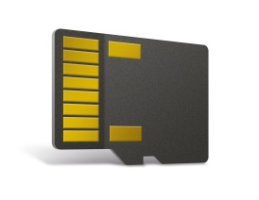
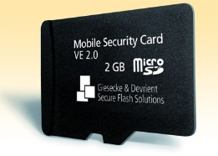
Authentication on Mobile Devices
Before 2016
Same needs as on our office computers
  Sign, send, and encrypt email
  Web authentication
Hardware challenge
  Connecting the smartphone to a smart card
Common Access Card (CAC) Sled issues
  Cost
  Separate battery
  User expectations
  Restricts BYOD
microSD card HSM
  Limited use pilots
  Requires specialized applications
  Not all devices support SD cards
Source: Mark Norton, DoD CIO MILCOM 2014 Presentation

Slide 3



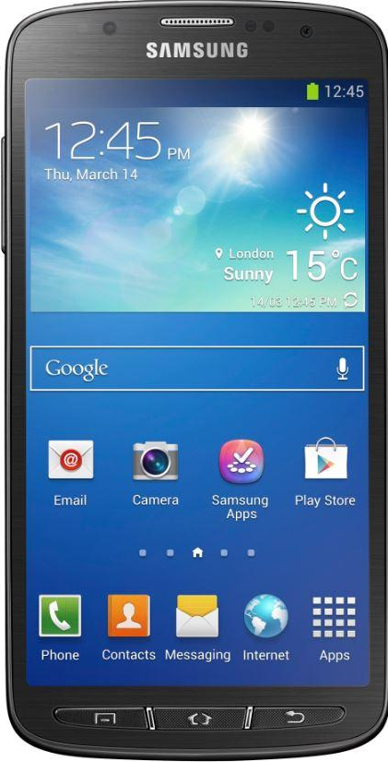

Authentication on Mobile Devices
2016+ Enter derived credentials issued to hardware-backed device native keystores
Derived from CAC
Derived

Slide 4
Authentication on Mobile Devices - DoD milestones
DoD CIO Mobile PKI Roadmap Memo – Sep 2014
  Within 90 days, the DoD PKI PMO in conjunction with the DoD Public Key Enabling (PKE) and DoD PKI engineering teams shall design the approach for implementing an enterprise derived PKI credential issuance service for unclassified Commercial Mobile Devices (CMDs)
NSA/DISA Industry Day – Oct 2015
  Introduction of Purebred and its requirements to industry
Purebred 1.0
  Initial Production Capability - August 2016
  Support for recovery of all user encryption keys – December 2016

Slide 5
What is Purebred?
Purebred issued derived credentials enable users to utilize mobile signed and encrypted email and secure web browsing to CAC enabled websites without a reader or sled
Purebred provides a secure over-the-air credentialing process through a series of one-time passwords and user demonstrated possession and usage of CAC
Comprised of a key management server and set of apps for mobile devices
  Certificate enrollment
  Encryption key recovery capabilities
Separates key management from device management
  Key management maintains affinity with PKI and is used across the enterprise, i.e., there is one DoD PKI used by all
  Device management can vary with operational scenario, i.e., different service/agency components can use different mobile device management (MDM) solutions

Slide 6
Purebred Supported Platforms
Supports four major mobile/tablet platforms & one USB platform
  Apple iOS 8, iOS 9, iOS 10, iOS 11
    Managed and unmanaged
  Android 5, Android 6, Android 7
    Samsung Knox
    Android for Work containers
    Unmanaged
  Windows 10 and Windows 10 Anniversary Universal Windows Platform (UWP)*
    Surface Pro 3 and Surface Pro 4
  Blackberry OS 10.3.3
    Work and personal
    Yubikey4
*Current ongoing DoD policy work with use of Virtual Smart Card and TPM technology

Slide 7
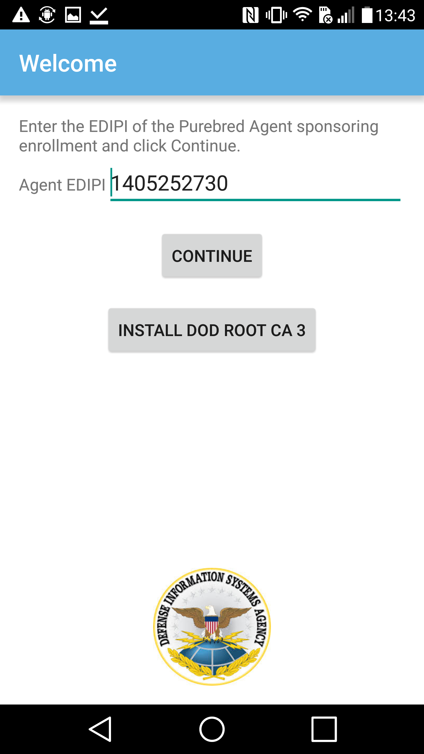
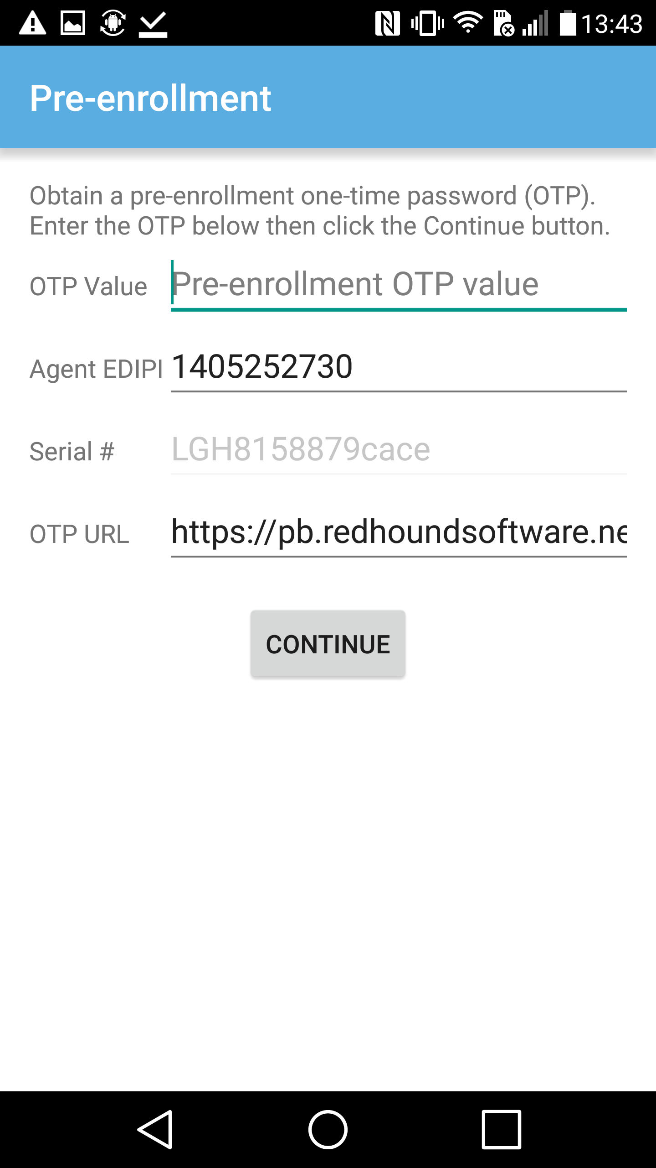
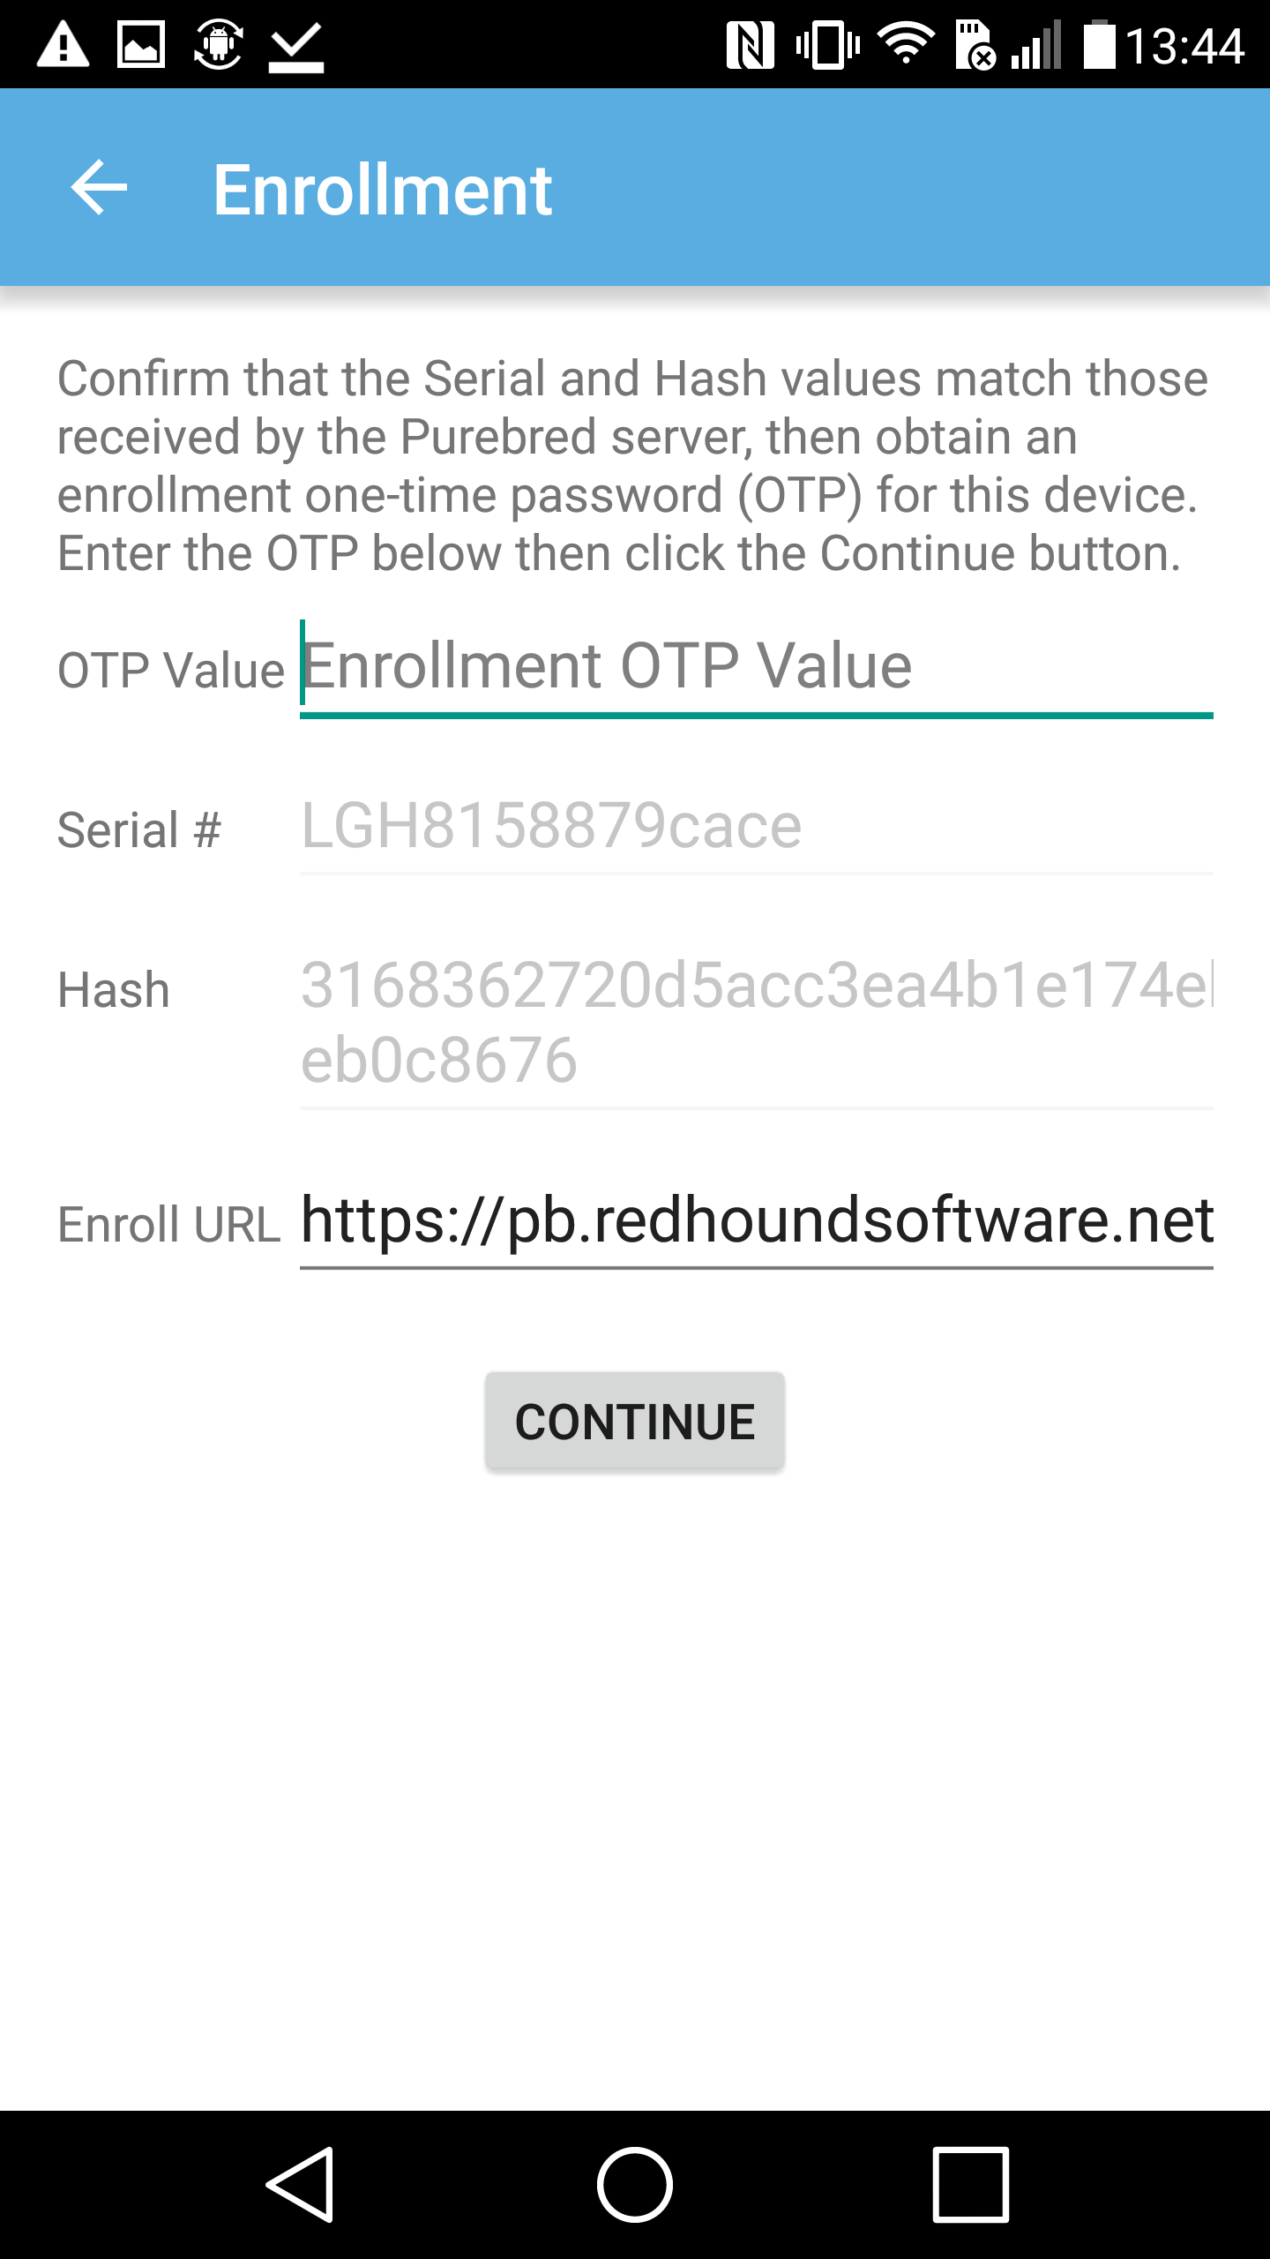
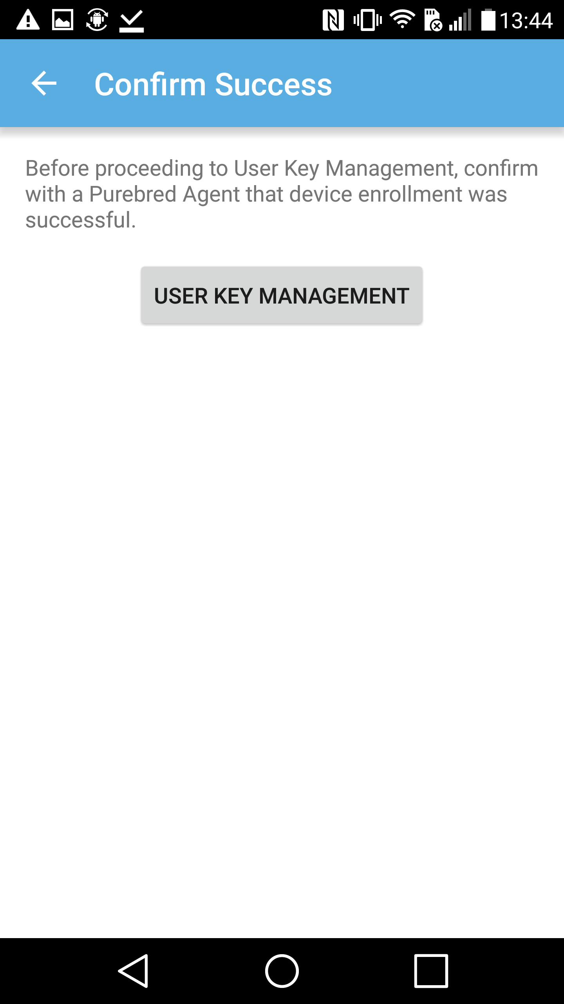
Purebred Agent Views
Info Collection/Phase 0/Vetting
Phase 1/Phase 2/SCEP/Phase 3
Notes:
There are two workflows: agent driven and user driven.
The purbred enrollment process can be broken in2 stages. Device and User enrollment. The purebred app contains 6 views in total
Device enrollment requires a Purebred Agent and
the first 4 views require the input of a Purebred Agents EDIPI and two one time passwords
At the end of the device stage, the user enrollment stage begins at the User Key Management Screen

Slide 8
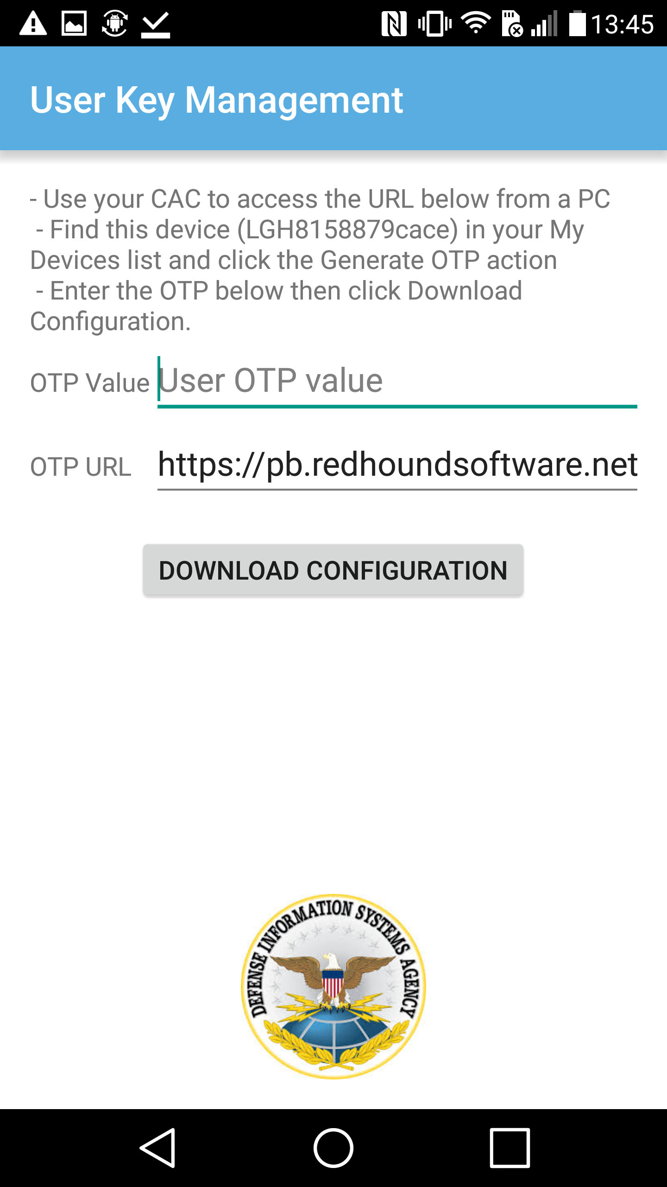
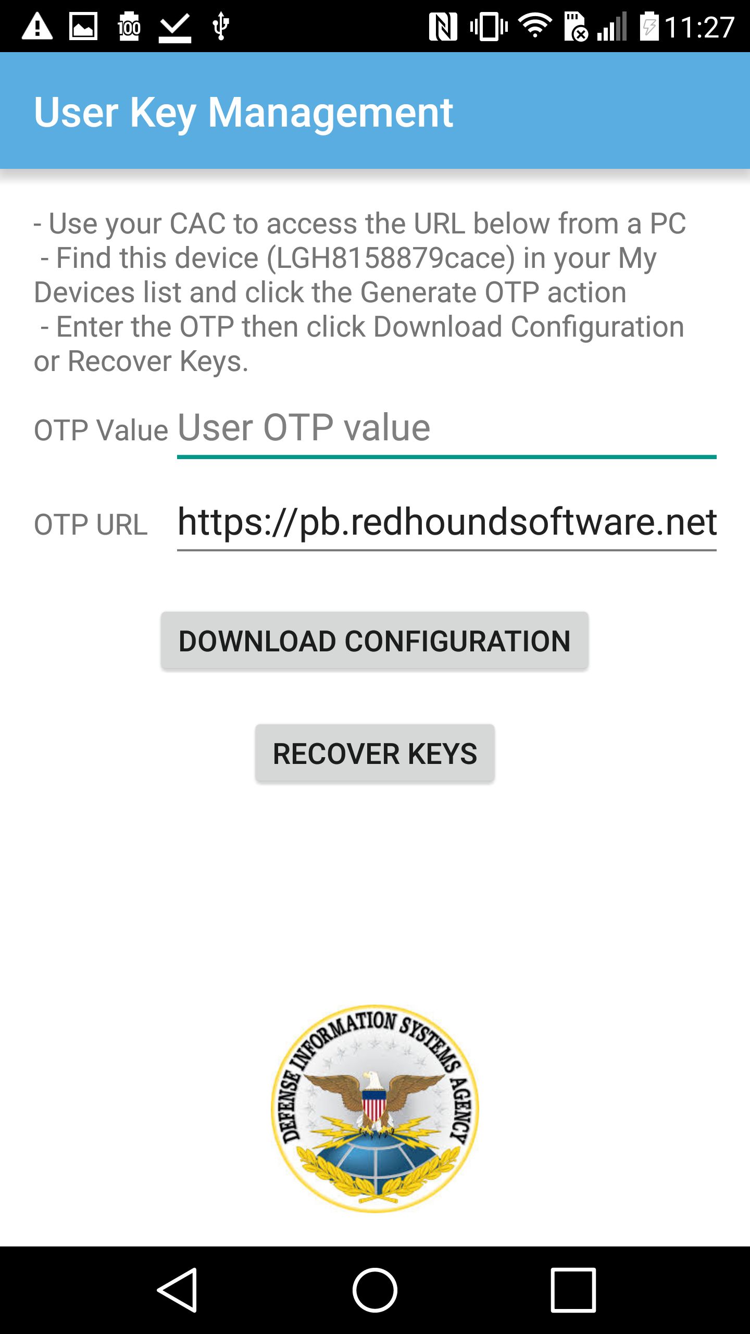
Purebred User Views
User Key Management Update
User Key Management Recovery
Notes:
The User enrollment stage contains 2 views. Requiring the user to enter a OTP for downloading the derived credential and and second OTP for retrieving recovered encryption keys

Slide 9
Purebred Status
Initial capability deployed Fall 2016
Averaging 2000-3000 devices enrolling per month and 50-100 new agents trained and granted permission to enroll device to Purebred across all DoD mission partners
Quarterly updates are deployed to provide new functionality and fixes
Top Purebred server priorities:
  1.4 - Attestation (hand off from Qualcomm contract, Samsung evaluation under way)
  1.5 - Server/Certificate Authority high availability/service redundancy
  2.0 – App and Server user interface improvement
  Release independent major tasks:
    Purebred reachability from internet (whitelisting)
    Agent nomination streamlining

Slide 10
Metrics (as of 28 Mar 2018)
Devices: 25,160 Agents: 1,370

Slide 11
Devices by Type (as of 28 Mar 2018)

Slide 12
Purebred Mission Partner Cost
No direct cost – no additional fee for service
  Purebred is a subcomponent of DoD Public Key Infrastructure (PKI)
  Purebred credentialing is an optional free entitlement under DoD Mobility Unclassified Capability (DMUC) or can be offered by any other mobility/mobile device management (MDM) service
In-direct costs to consider
  Initial Integration Support
    Engineering and Test/Evaluation
    Deploying PB registration app
    Configuring MDM policies
    Profile configuration management
    General accreditation activities
  Purebred Agent Staffing (Sustainment)
    Agent nomination (what org/who will be agents?, is it in-scope if contractor?)
    Enrollment support activities Training (free, provided by DISA)
    User list management for migrations

Slide 13
Purebred Links
Information
Purebred Information - https://iase.disa.mil/pki-pke/Pages/purebred.aspx
Purebred Agent Collaboration - https://www.milsuite.mil/book/groups/disa-purebred-agents-group

